Slide 1
Cloud Applications
Bachelorproef Automatisering

Slide 2
Solved UserStories
See information about a repo on the site with a single buttonpress
See how active the student is within the repo
Open repos without having to look up the link
Write comments on a students’ commit via the website
Search student in the list of all my students
Good looking website with a good overview
Read markdown files on the website (scriptie, logfiles)
I want basic information to be extracted automatically

Slide 3
Adjusted UserStories
Create a single issue for multiple comments on the scription
Recieve a mail when a new logfile is pushed to repo
As a Student i want to be notified when the original repo changes

Slide 4
Unnecessairy UserStories
Filter students by promotor so I don’t have to search for them
Add, remove or edit students from the list
Create notes for my students only visible by me
Read and edit code using the website

Slide 5
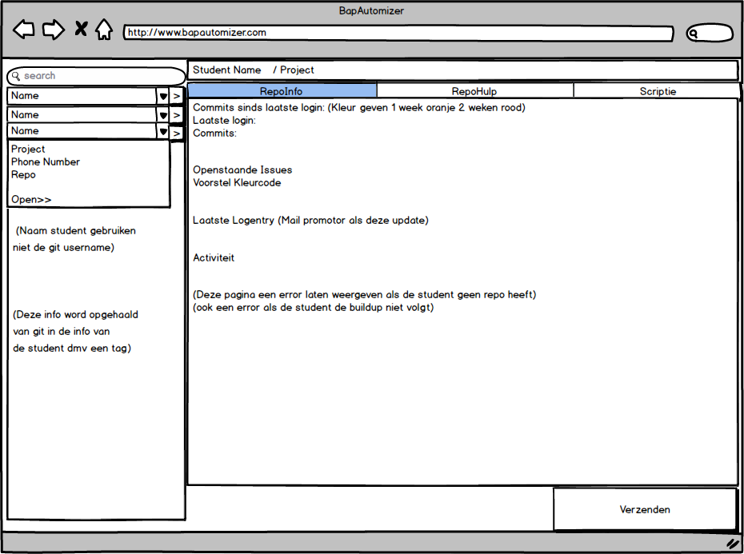
Mockups

Slide 6
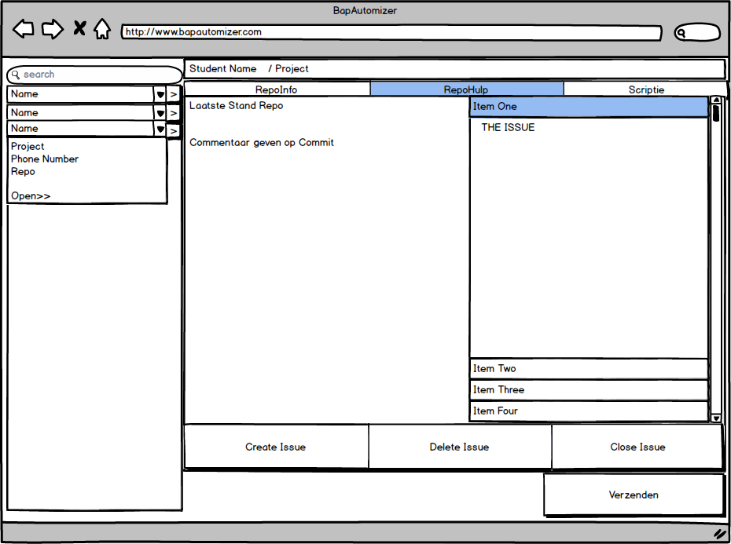
Mockups

Slide 7
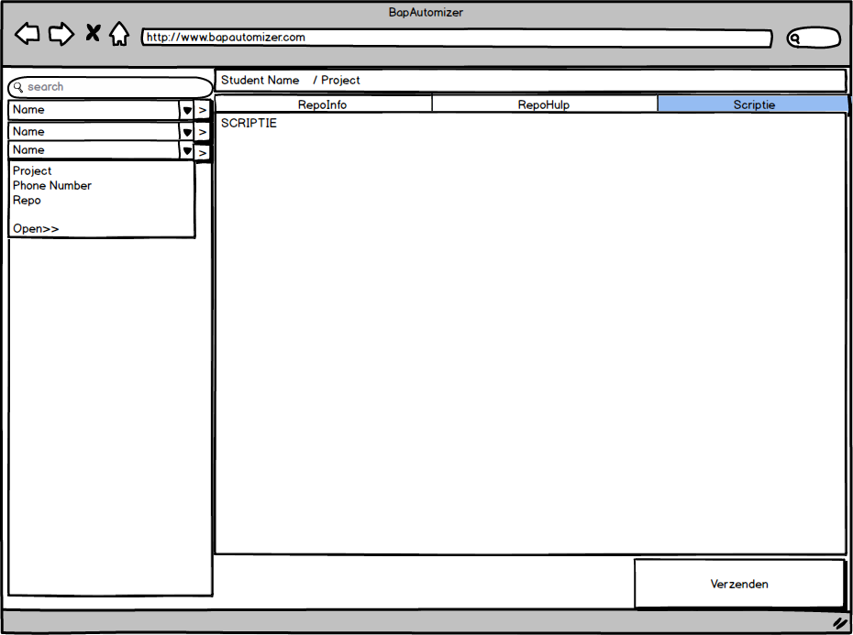
Mockups

Slide 8
Deployment Diagram
Client
Token
Exchange
Server
Angular
Bootstrap
CSS
Javascript
HTML
Git Calls
Github API
Node
Express
Sendgrid API
Usercode ->
Access <-

Slide 9
Demo

